Slide 1
Project Management Software
Nicholas Whitton

Slide 2
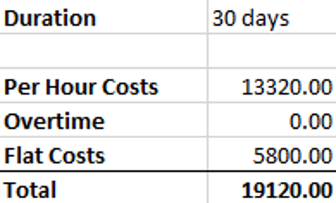
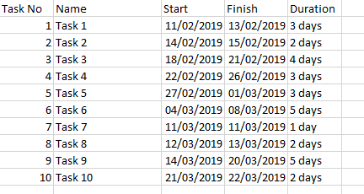
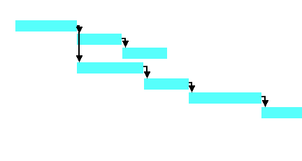
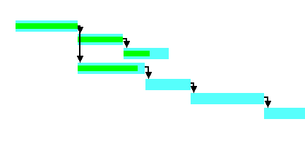
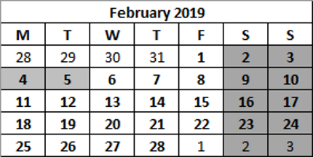
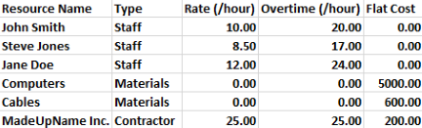
Common Elements
Task Scheduling
Visual Representation of Schedule
Progress Tracking
Resource List
Cost Estimation
Customisable Calendars

Slide 3
Task Scheduling
Stores when each task should start and finish, and how long it is expected to take.
Often allows for dependencies to be added between tasks.
Can often assign resources to tasks.
Some can look for conflicting resources.

Slide 4
Visual Representation of Schedule
Allows for easy reading by humans.
Usually in the form of a Gantt chart (left) or other common chart (e.g. PERT Chart).
Often allows the critical path to be highlighted.

Slide 5
Progress Tracking
Allows easy reading of how far the team has progressed through each task.
Makes it obvious if the project has fallen behind.
Requires that someone manually enter the progress regularly.

Slide 6
Resource List
Allows tracking of what resources may be available to the project, and how much they will cost.
Resources in the list, especially staff, may often be assigned to specific tasks.

Slide 7
Cost Estimation
Uses resource list and task schedule to calculate how much it will cost to assign those resources to their tasks, based on rates and durations.
Can only give a rough value, as unforeseen effects such as delays can mean that overtime is required.

Slide 8
Customisable Calendars
Allows the program to account for staff who may have different working hours (e.g. Part Time staff), or who may be going on holiday.
Calendars can be assigned to resources in the resource list to keep track of who will be available when.

Slide 9
Commonly Used Programs

Slide 10
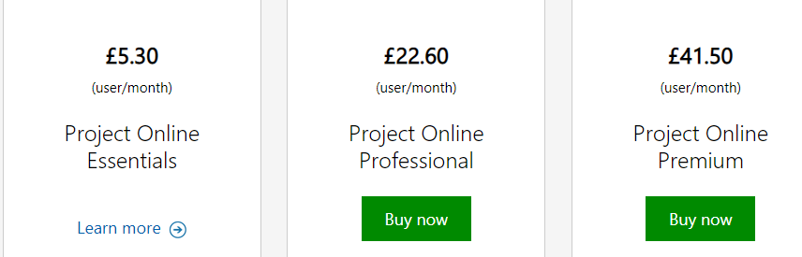
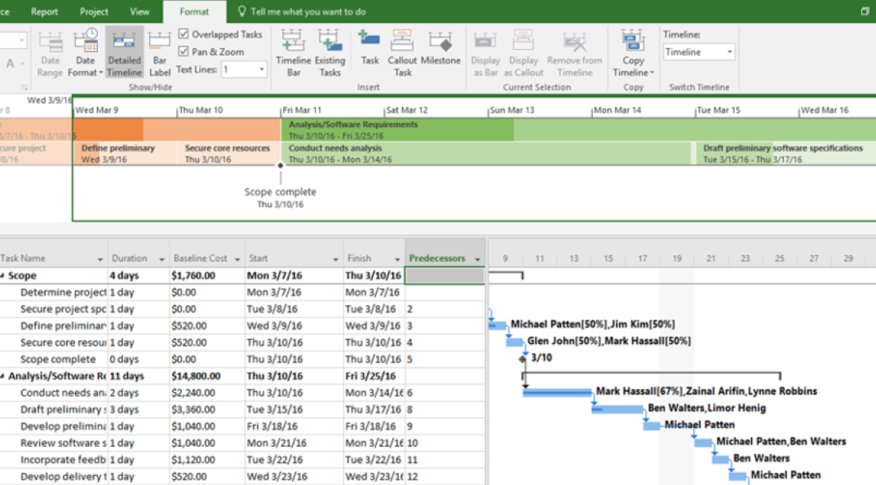
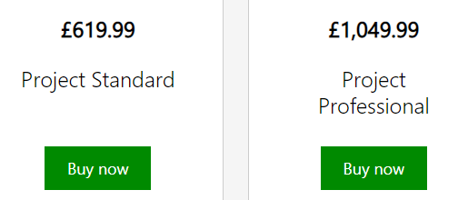
MICROSOFT PROJECT
Very comprehensive project management program.
Has all features listed above, and many more.
EXPENSIVE!

Slide 11
Are the Alternatives Any Better
Many programs and online tools which market themselves as rivals to MS Project have begun to charge higher rates, averaging $180 (£139)/user/year for online tools.[1]
Using numbers from the previous slide, MS Project costs £271.20/user/year for the professional version and £498/user/year for the premium version.
While many of the alternatives have evolved beyond simple Gantt chart tools, including many other features, most still do not offer anywhere near as much functionality as MS Project.
Choosing your tool then becomes a simple question:
Which features do you actually need, and which are just adding cost but will never be used?

Slide 12
Case Study

Slide 13
Case Study 2 – Group Account Invoicing
A good project management program is essential for this sort of job.
The project manager has to:
know roughly how long each task will take, and therefore be able to work out how long the project as a whole will take
keep track of progress towards deadlines
know which people will be involved in each stage of the process, and when they will be available
give the company (IOE) a rough estimate of how much it will cost
The company itself probably has a preferred tool which may be on their computers already. If the project manager does not wish to use this, they should at least choose one which can save their work in a compatible format.

Slide 14
Sources
https://thedigitalprojectmanager.com/microsoft-project-alternatives/
https://products.office.com/en-gb/project/compare-microsoft-project-management-software
https://products.office.com/en-gb/project/project-and-portfolio-management-software

